Slide 2
Decision Trees & Ensemble Models
Lecture 5

Slide 3
Course Schedule
Lecture 1: Introduction to Tree-Based Method
Lecture 2: Bias-Variance Tradeoff and Ensembling Approaches
Lecture 3: Bootstrap sampling
Lecture 4: Random Forests
Lecture 5: Boosting
Lecture 6: Project Presentation

Slide 4
Agenda
Class review
Motivating Boosting
Gradient Boosting
Some Gradient Boosting Methods/Libraries
XGBoost
LightGBM
CatBoost

Slide 5
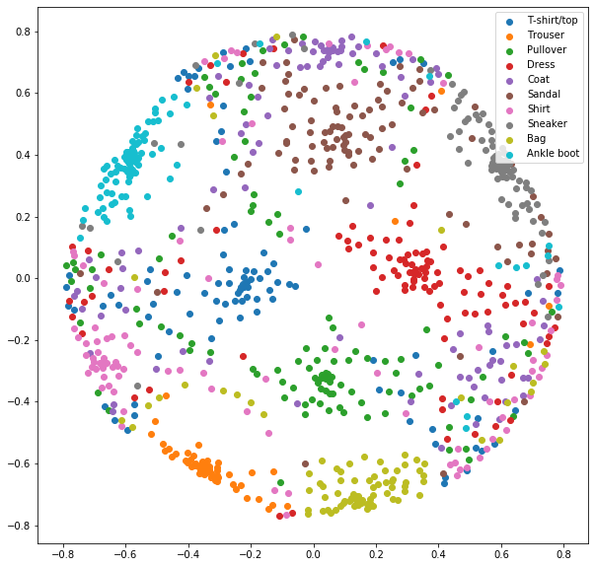
We met Proximities
Random forest can be used to transform your data in a non-linear way into potentially more useful features.
Proximities are obtained by using distances in those transformed features to measure similarity of datapoints

Slide 6
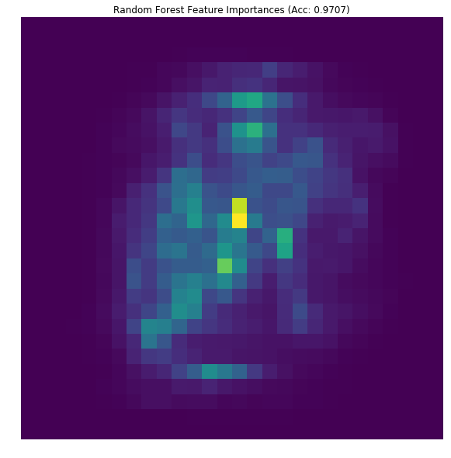
We met Feature Importances
We also discussed how the structure of tree based methods gives an explicitly way of measuring how useful every feature was to making the decision.
This provides a useful lens not only during feature engineering, and data visualization, but also an incredible tool for deducing conclusions from learned models.

Slide 7
Agenda
Class review
Motivating Boosting
Gradient Boosting
Gradient Boosting Libraries
XGBoost
LightGBM
CatBoost

Slide 8
Today’s Goal
Aggregating trees in parallel on data is nice, it allows us to reduce variance with a small tradeoff in bias
It would be nice if we could also somehow do the opposite: aggregate models to reduce bias without introducing too much variance
Boosting is a tool that lets us do exactly this!

Slide 9
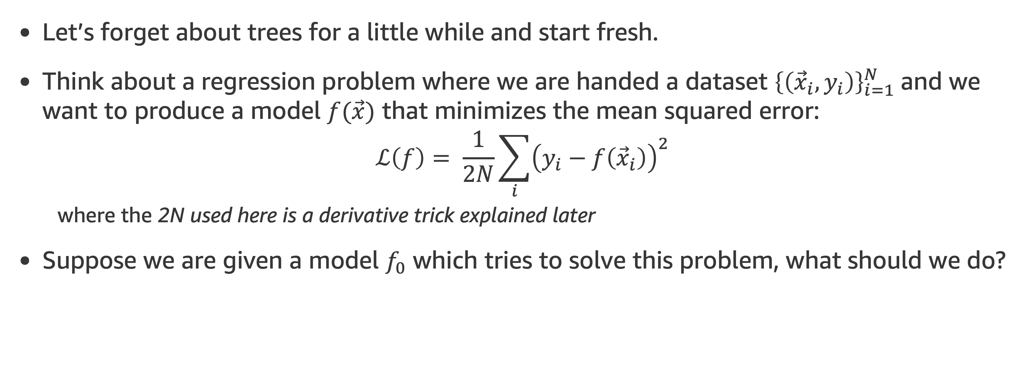
What is the idea?
Let’s forget about trees for a little while and start fresh.
Think about a regression problem where we are handed a dataset ${\left\{\left({\vec{x}}_{i}, y_{i}\right)\right\}}_{i=1}^{N}$and we want to produce a model $f(\vec{x})$ that minimizes the mean squared error:
$$ℒ\left(f\right)= \frac{1}{2N}\sum_{i}{{\left(y_{i}−f\left({\vec{x}}_{i}\right)\right)}^{2}}$$
where the 2N used here is a derivative trick explained later
Suppose we are given a model $f_{0}$ which tries to solve this problem, what should we do?

Slide 10
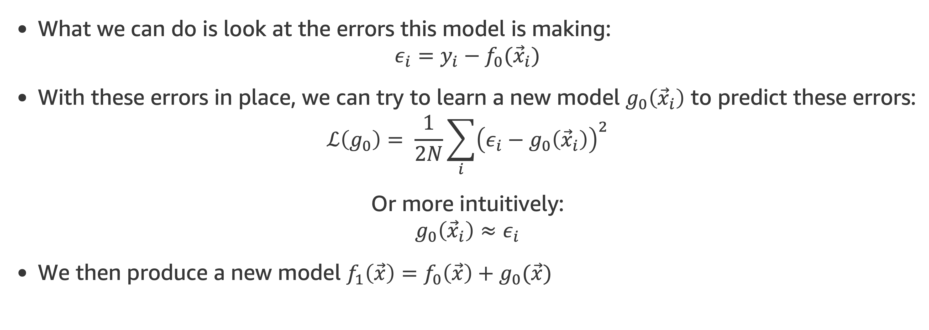
What is the idea?
What we can do is look at the errors this model is making:
$$ε_{i}=y_{i}−f_{0}({\vec{x}}_{i})$$
With these errors in place, we can try to learn a new model $g_{0}\left({\vec{x}}_{i}\right)$ to predict these errors:
$$ℒ\left(g_{0}\right)= \frac{1}{2N}\sum_{i}{{\left(ε_{i}−g_{0}\left({\vec{x}}_{i}\right)\right)}^{2}}$$
Or more intuitively:
$$g_{0}\left({\vec{x}}_{i}\right)≈ε_{i}$$
We then produce a new model $f_{1}\left(\vec{x}\right)=f_{0}\left(\vec{x}\right)+g_{0}(\vec{x})$

Slide 11
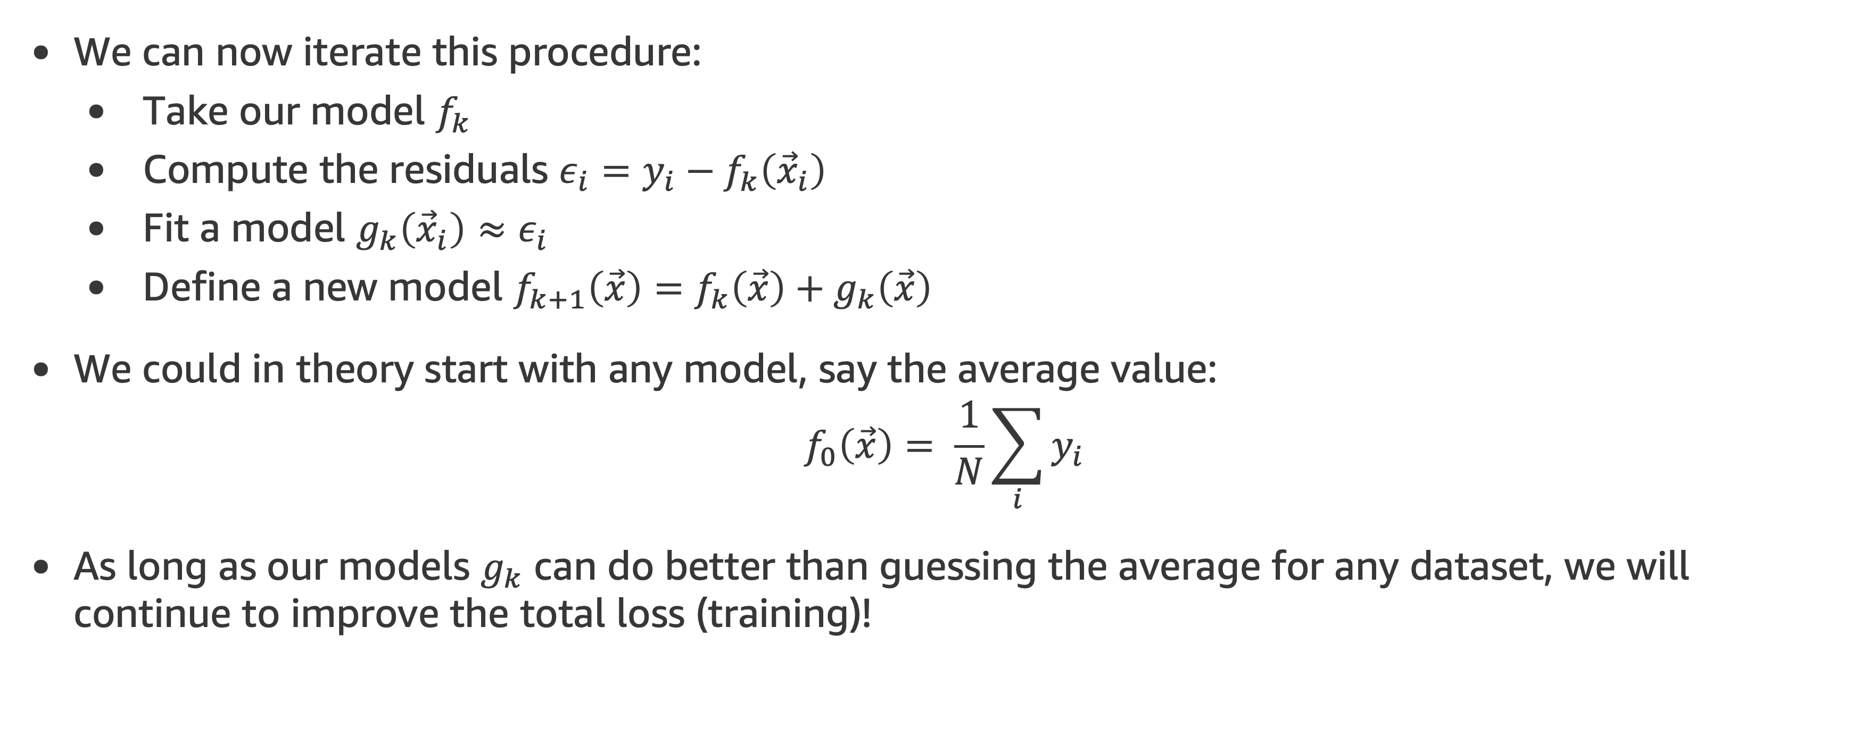
What is the idea?
We can now iterate this procedure:
Take our model $f_{k}$
Compute the residuals $ε_{i}=y_{i}−f_{k}\left({\vec{x}}_{i}\right)$
Fit a model $g_{k}\left({\vec{x}}_{i}\right)≈ε_{i}$
Define a new model $f_{k+1}\left(\vec{x}\right)=f_{k}\left(\vec{x}\right)+g_{k}\left(\vec{x}\right)$
We could in theory start with any model, say the average value:
$$f_{0}\left(\vec{x}\right)= \frac{1}{N}\sum_{i}{y_{i}}$$
As long as our models $g_{k}$ can do better than guessing the average for any dataset, we will continue to improve the total loss (training)!

Slide 12
What do we mean by improve at all?
This is a special case of a concept known as a weak learner:
For regression: can the model reduce the mean squared error on any dataset compared to guessing the average value
For classification: can the model do better on any dataset compared to random guessing
The concept itself is quite technical, I recommend reading this blog post for some extra details.
A good example would be a short decision tree (say with less than 10 nodes) or even a decision stump: a tree with a single node!
While often used, it is worth noting that a decision stump is too weak
These weak learners are almost always high bias.

Slide 13
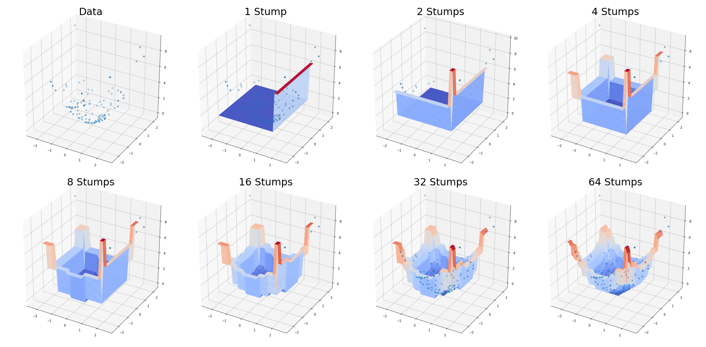
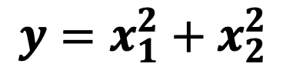
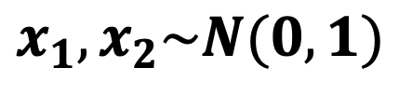
Boosting Example
$$x_{1}, x_{2}\sim N(0, 1)$$
$$y=x_{1}^{2}+x_{2}^{2}$$
x₂
x₁
DTE-LECTURE-5-BOOSTING.ipynb

Slide 14
Agenda
Class review
Motivating Boosting
Gradient Boosting
Gradient Boosting Libraries
XGBoost
LightGBM
CatBoost

Slide 15
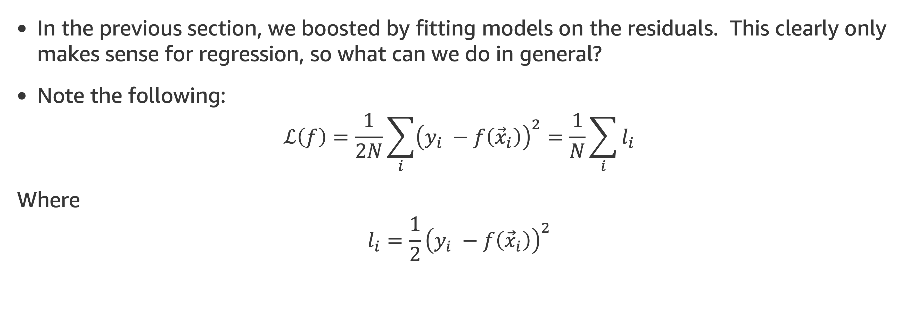
Generalizing
In the previous section, we boosted by fitting models on the residuals. This clearly only makes sense for regression, so what can we do in general?
Note the following:
$$ℒ\left(f\right)=\frac{1}{2N}\sum_{i}{{\left(y_{i} −f\left({\vec{x}}_{i}\right)\right)}^{2}}=\frac{1}{N}\sum_{i}{l_{i}}$$
Where
$$l_{i}=\frac{1}{2}{\left(y_{i} −f\left({\vec{x}}_{i}\right)\right)}^{2}$$

Slide 16
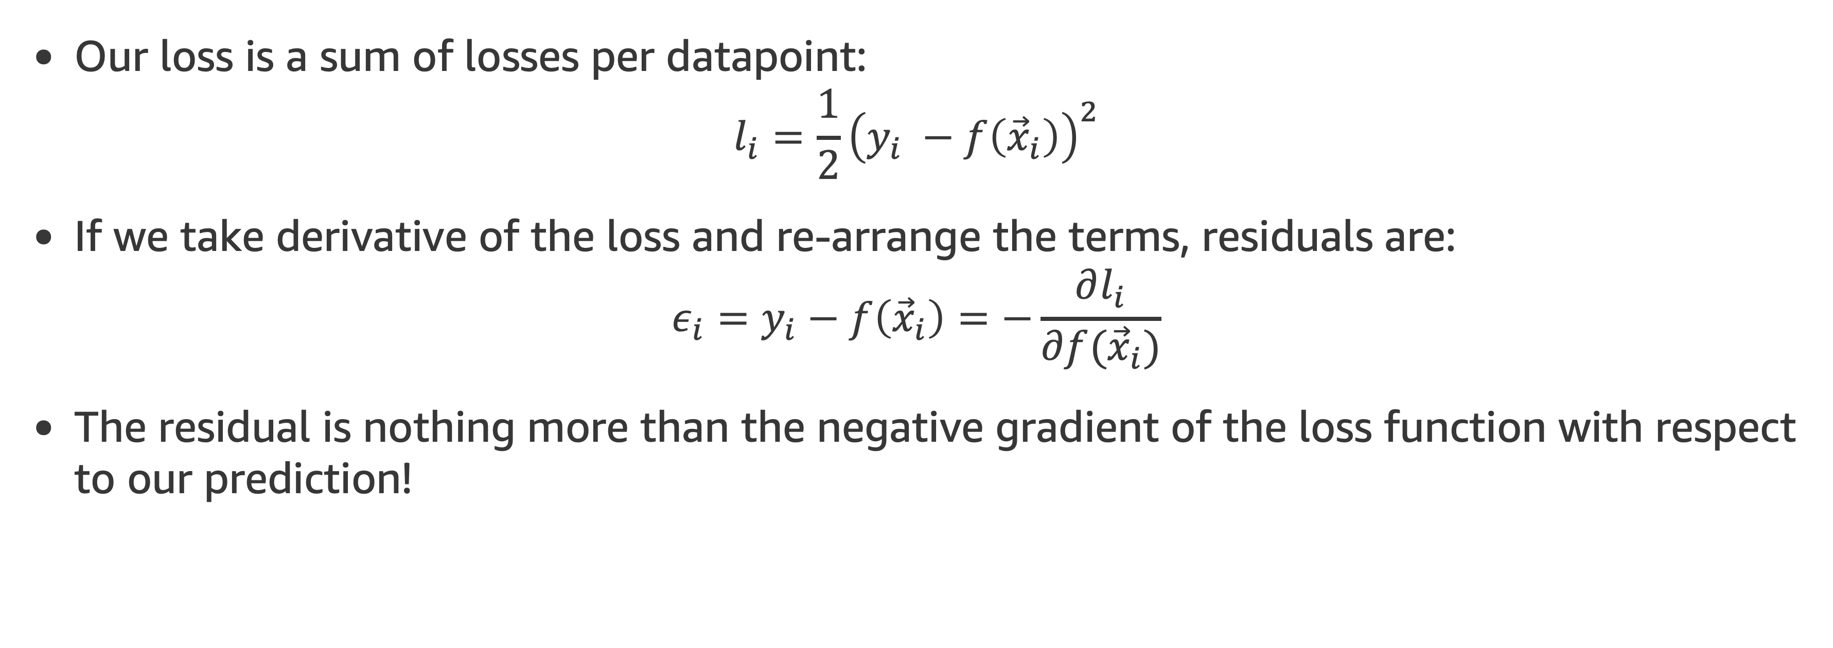
Generalizing
Our loss is a sum of losses per datapoint:
$$l_{i}=\frac{1}{2}{\left(y_{i} −f\left({\vec{x}}_{i}\right)\right)}^{2}$$
If we take derivative of the loss and re-arrange the terms, residuals are:
$$ε_{i}=y_{i}−f\left({\vec{x}}_{i}\right)=−\frac{∂l_{i}}{∂f({\vec{x}}_{i})}$$
The residual is nothing more than the negative gradient of the loss function with respect to our prediction!

Slide 17
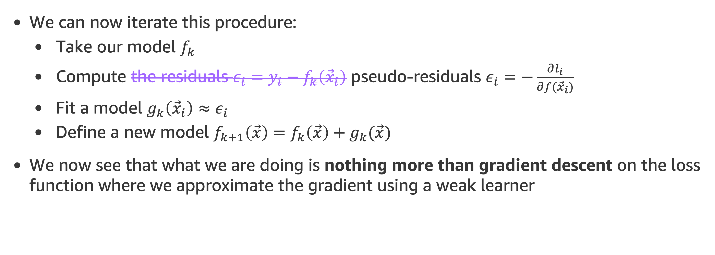
Generalizing
We can now iterate this procedure:
Take our model $f_{k}$
Compute the residuals $ε_{i}=y_{i}−f_{k}\left({\vec{x}}_{i}\right)$ pseudo-residuals $ε_{i}=−\frac{∂l_{i}}{∂f({\vec{x}}_{i})}$
Fit a model $g_{k}\left({\vec{x}}_{i}\right)≈ε_{i}$
Define a new model $f_{k+1}\left(\vec{x}\right)=f_{k}\left(\vec{x}\right)+g_{k}(\vec{x})$
We now see that what we are doing is nothing more than gradient descent on the loss function where we approximate the gradient using a weak learner

Slide 18
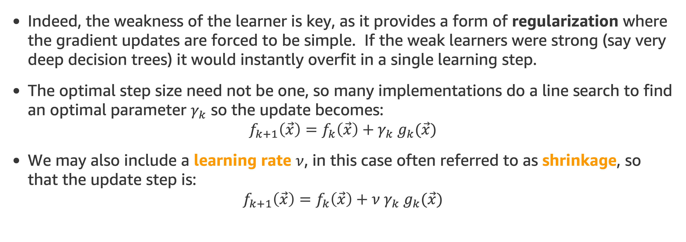
A few comments
Indeed, the weakness of the learner is key, as it provides a form of regularization where the gradient updates are forced to be simple. If the weak learners were strong (say very deep decision trees) it would instantly overfit in a single learning step.
The optimal step size need not be one, so many implementations do a line search to find an optimal parameter $γ_{k}$ so the update becomes:
$$f_{k+1}\left(\vec{x}\right)=f_{k}\left(\vec{x}\right)+γ_{k} g_{k}(\vec{x})$$
We may also include a learning rate $ν$, in this case often referred to as shrinkage, so that the update step is:
$$f_{k+1}\left(\vec{x}\right)=f_{k}\left(\vec{x}\right)+{ν γ}_{k} g_{k}(\vec{x})$$

Slide 19
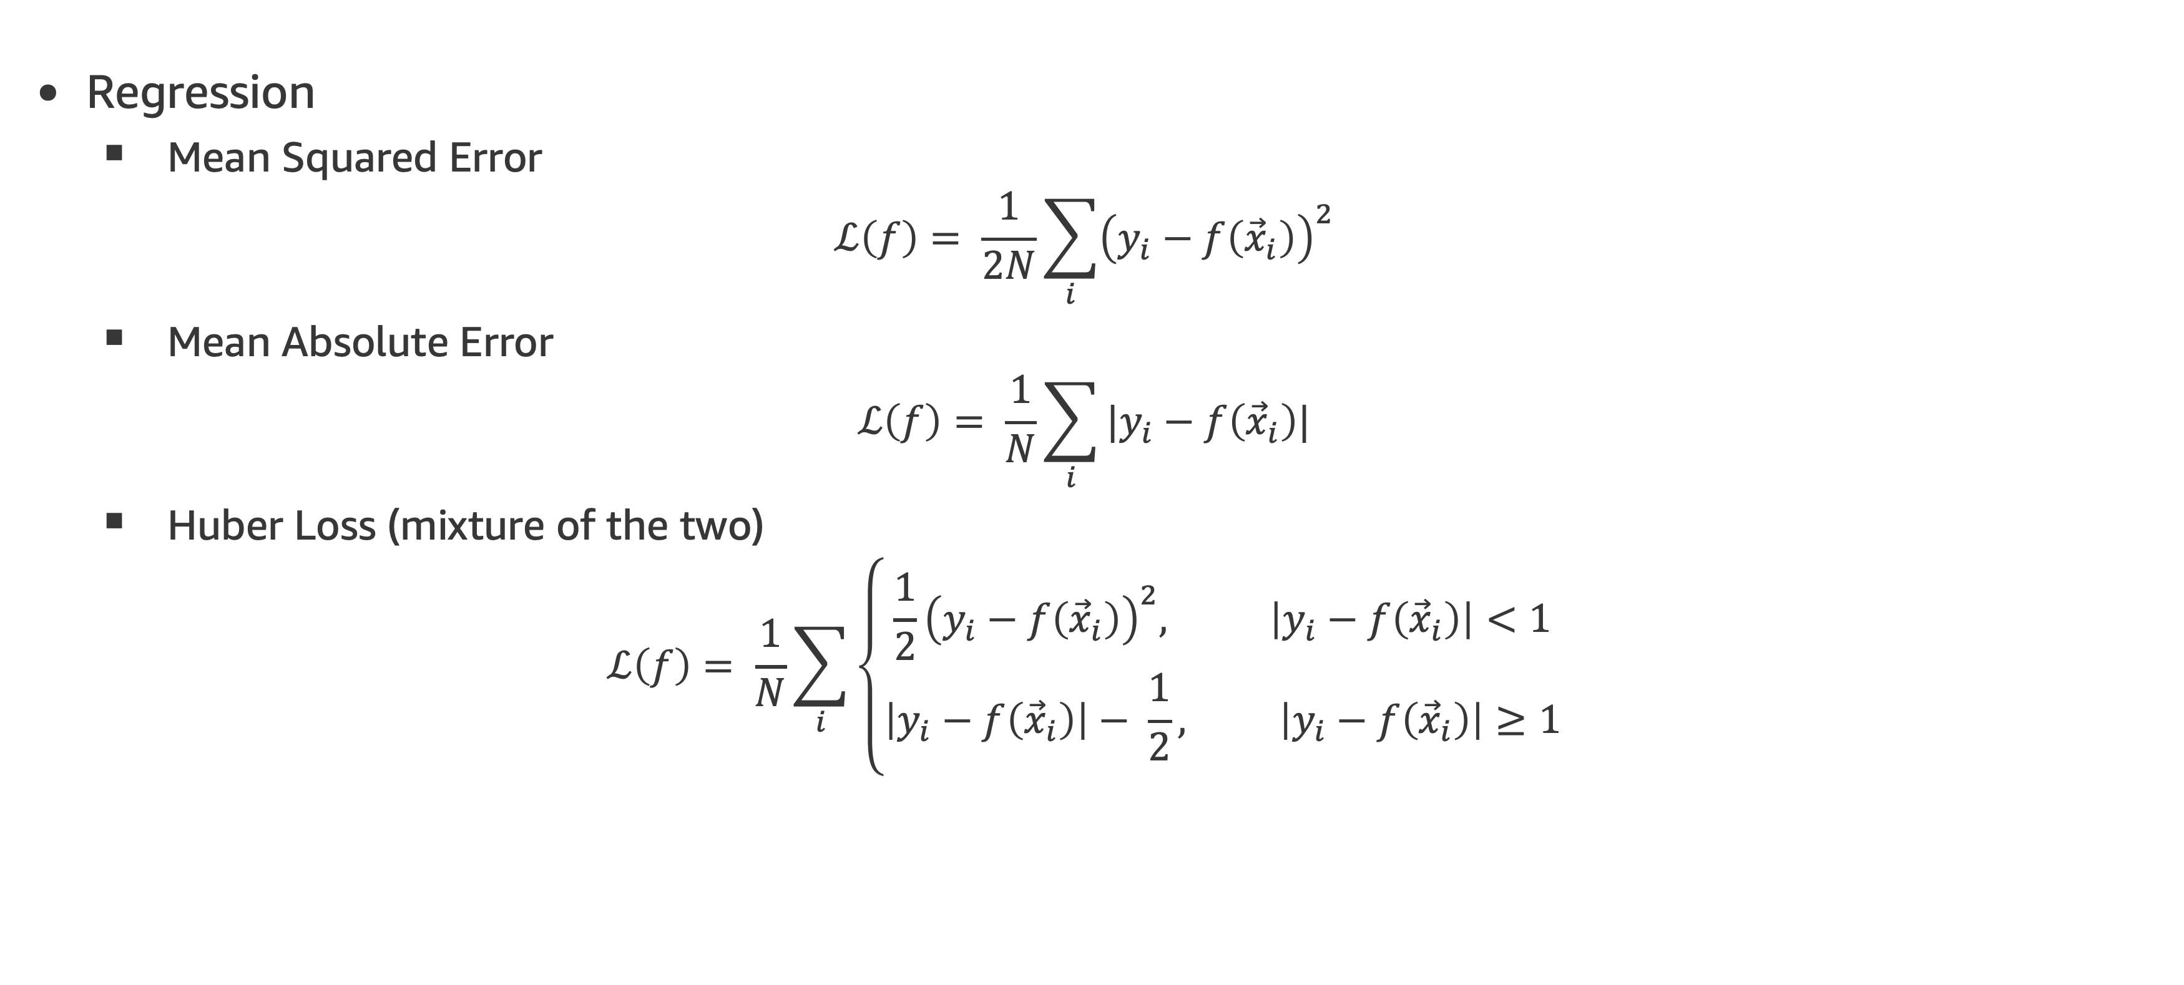
Common Choices of Loss Functions
Regression
Mean Squared Error
$$ℒ\left(f\right)= \frac{1}{2N}\sum_{i}{{\left(y_{i}−f\left({\vec{x}}_{i}\right)\right)}^{2}}$$
Mean Absolute Error
$$ℒ\left(f\right)= \frac{1}{N}\sum_{i}{|y_{i}−f\left({\vec{x}}_{i}\right)|}$$
Huber Loss (mixture of the two)
$$ℒ\left(f\right)= \frac{1}{N}\sum_{i}{\left\{\begin{aligned}\frac{1}{2}{\left(y_{i}−f\left({\vec{x}}_{i}\right)\right)}^{2}, \left|y_{i}−f\left({\vec{x}}_{i}\right)\right|<1 \\ &\left|y_{i}−f\left({\vec{x}}_{i}\right)\right|− \frac{1}{2}, \left|y_{i}−f\left({\vec{x}}_{i}\right)\right|≥1\end{aligned}\right.}$$

Slide 20
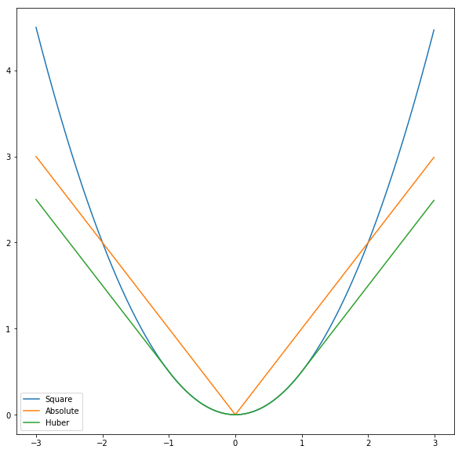
Common Choices of Loss Functions

Slide 21
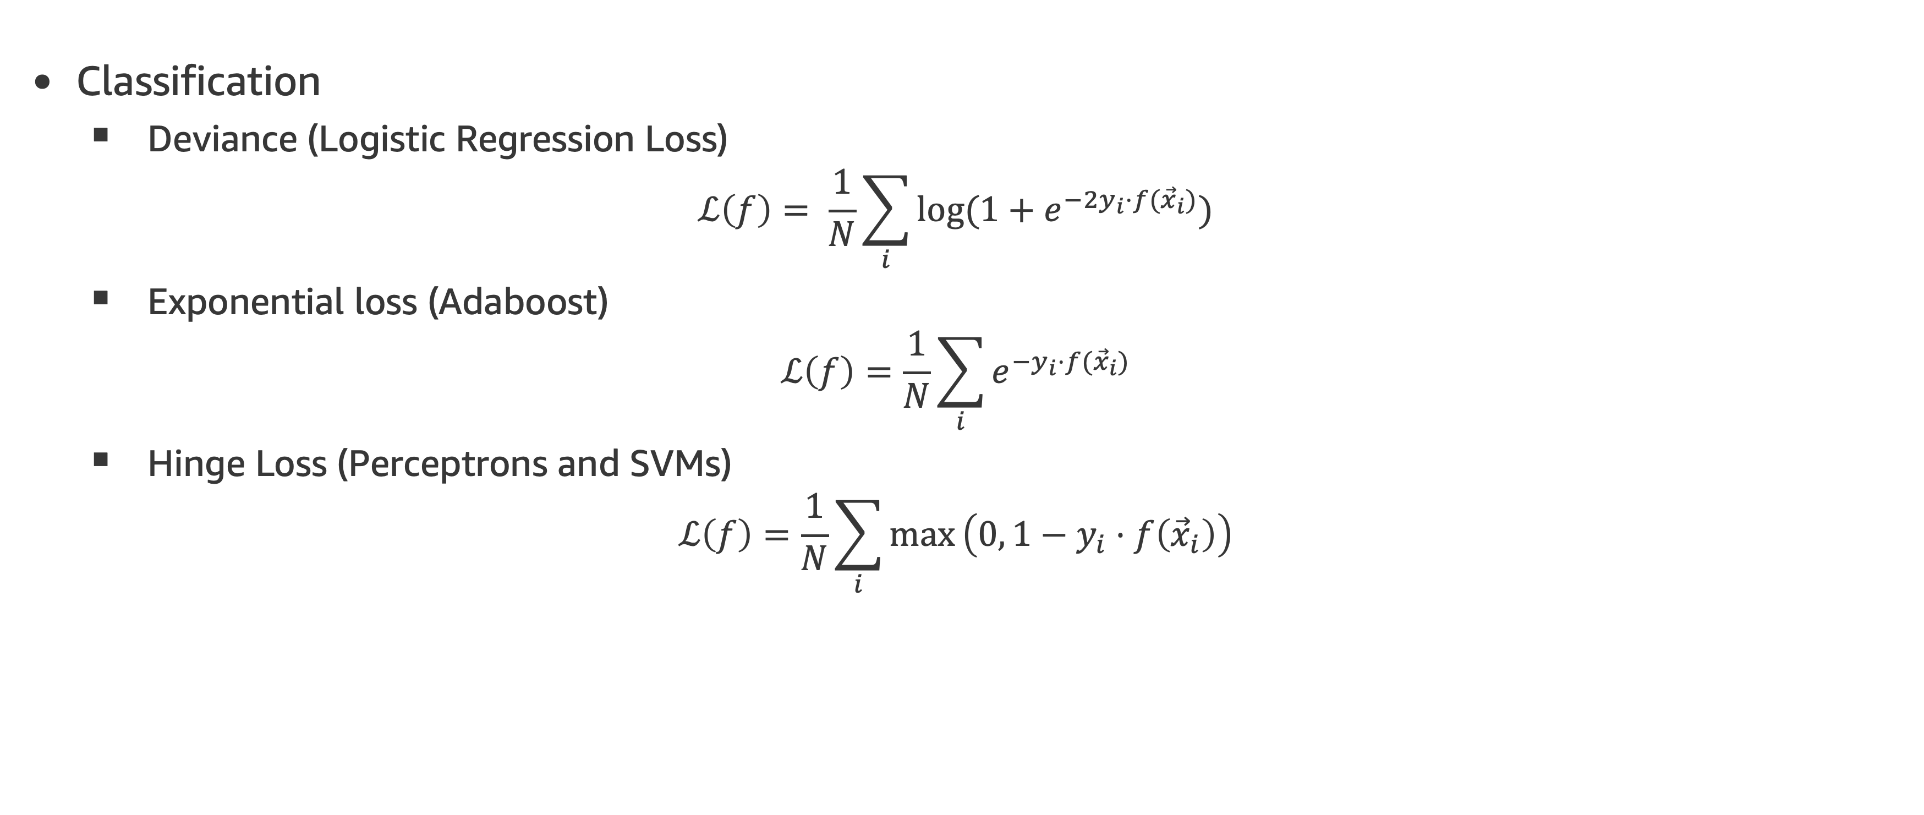
Common Choices of Loss Functions
Classification
Deviance (Logistic Regression Loss)
$$ℒ\left(f\right)= \frac{1}{N}\sum_{i}{\log{{(1+e}^{−2y_{i}⋅f({\vec{x}}_{i})})}}$$
Exponential loss (Adaboost)
$$ℒ\left(f\right)=\frac{1}{N}\sum_{i}{e^{−y_{i}⋅f({\vec{x}}_{i})}}$$
Hinge Loss (Perceptrons and SVMs)
$$ℒ\left(f\right)=\frac{1}{N}\sum_{i}{max}\left(0, 1−y_{i}⋅f\left({\vec{x}}_{i}\right)\right)$$

Slide 22
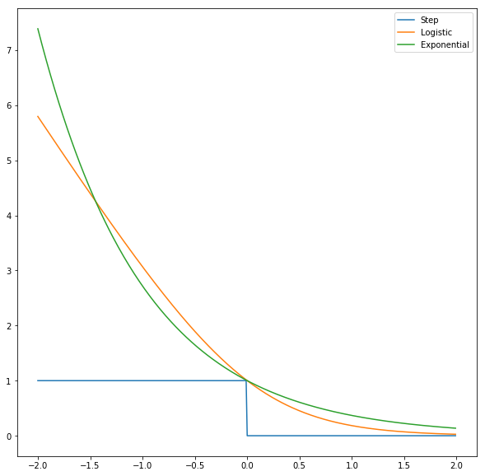
Common Choices of Loss Functions

Slide 23
Agenda
Class review
Motivating Boosting
Gradient Boosting
Gradient Boosting Libraries
XGBoost
LightGBM
CatBoost

Slide 24

XGBoost stands for “Extreme Gradient Boosting”
Algorithm details are described in the 2016 paper* here.
Some contributions of this model (there are many more):
Approximate Greedy Algorithm
Reformulate split conditions and gains considering weights on leaves.
Performance improvement techniques: Parallel blocks, Cache-aware Access and Out-of-core computation
* Chen, T. & Guestrin, C. Xgboost: A scalable tree boosting system. In Proc. 22nd ACM SIGKDD International Conference on Knowledge Discovery and Data Mining 785–794 (ACM, 2016).

Slide 25
Approximate Greedy Algorithm
Trying all possible split thresholds can be time consuming for large datasets.
XGBoost uses quantiles as threshold candidates. Assume a feature x₁ ordered like this:
High
X₁< ?
0.75 quantile
x₁
0.5 quantile
0.25 quantile
Low

Slide 26
Approximate Greedy Algorithm
Trying all possible split thresholds can be time consuming for large datasets.
XGBoost uses quantiles as threshold candidates. Assume a feature ordered like this:
High
X₁< ?
0.75 quantile
We can use these three quantiles as the splits to try.
There are usually more than three quantiles and they apply some extra optimizations to do this in parallel.
x₁
0.5 quantile
0.25 quantile
Low

Slide 27
XGBoost Interface
Here is the XGBoostClassifier interface with some default parameters. The full interface is longer.
XGBClassifier(max_depth=3,
learning_rate=0.1,
n_estimators=100,
objective='binary:logistic’,
booster='gbtree’,
n_jobs=1,
…)

Slide 28
LightGBM
A highly efficient gradient boosting method and library that came out in 2017. The original paper is here.
Main contributions:
Gradient-based One-Side Sampling (GOSS): Puts more focus on under-trained data points.
Exclusive Feature Bundling (EFB): Efficient representation for sparse features such as one-hot-encoded features.

Slide 29
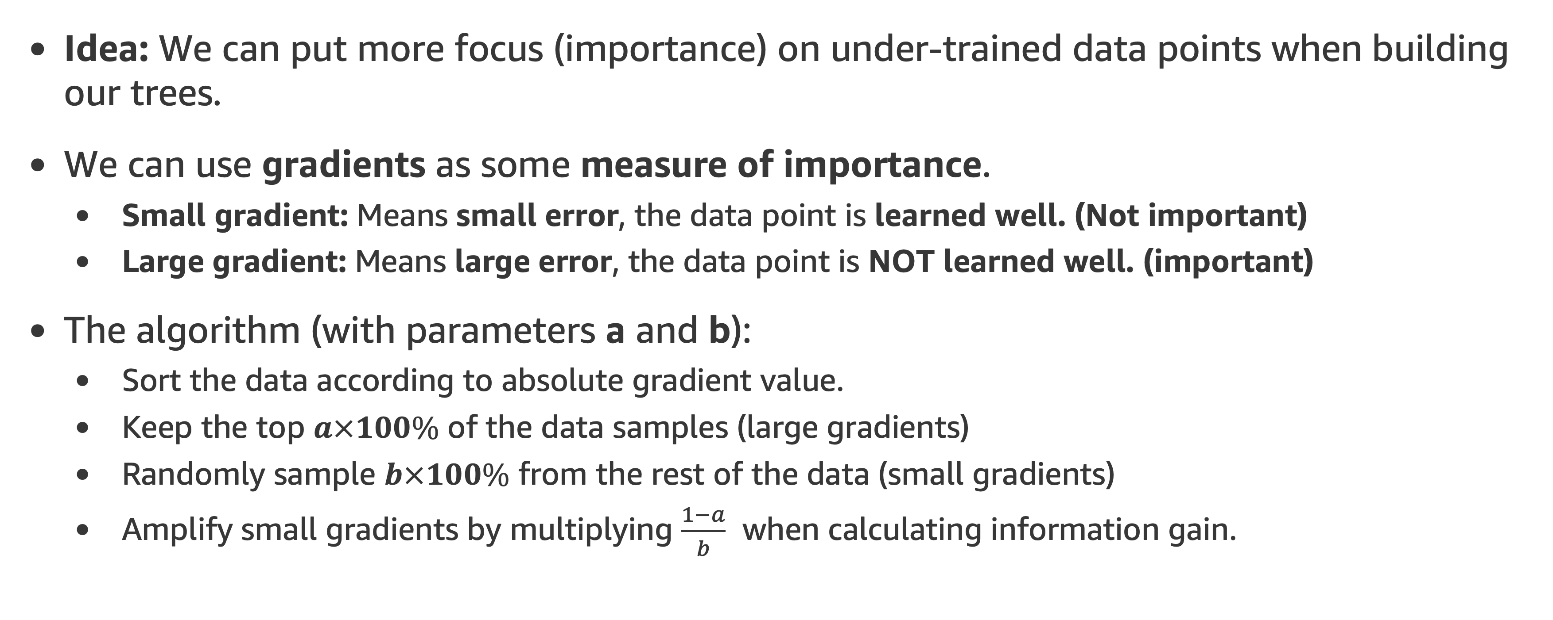
Gradient-based One-Side Sampling (GOSS):
Idea: We can put more focus (importance) on under-trained data points when building our trees.
We can use gradients as some measure of importance.
Small gradient: Means small error, the data point is learned well. (Not important)
Large gradient: Means large error, the data point is NOT learned well. (important)
The algorithm (with parameters a and b):
Sort the data according to absolute gradient value.
Keep the top $a×100\%$ of the data samples (large gradients)
Randomly sample $b×100\%$ from the rest of the data (small gradients)
Amplify small gradients by multiplying $\frac{1−a}{b}$ when calculating information gain.

Slide 30
Exclusive Feature Bundling (EFB)
A nice way to reduce number of features by taking advantage of sparsity of large datasets.
The main observation is many features are never non-zero at the same time. Therefore, we can merge (bundle) them and save space by doing that.
Example:
Feature 1 | Feature 2 | Feature 3
0 | 1 | 2
0 | 0 | 0
1 | 3 | 0
0 | 0 | 3
5 | 0 | 0
0 | 0 | 7

Slide 31
Exclusive Feature Bundling (EFB)
A nice way to reduce number of features by taking advantage of sparsity of large datasets.
The main observation is many features are never non-zero at the same time. Therefore, we can merge (bundle) them and save space by doing that.
Example:
Feature 1 | Feature 2 | Feature 3
0 | 1 | 2
0 | 0 | 0
1 | 3 | 0
0 | 0 | 3
5 | 0 | 0
0 | 0 | 7
We cannot merge Feature 1 and Feature 2. There is overlap

Slide 32
Exclusive Feature Bundling (EFB)
A nice way to reduce number of features by taking advantage of sparsity of large datasets.
The main observation is many features are never non-zero at the same time. Therefore, we can merge (bundle) them and save space by doing that.
Example:
Feature 1 | Feature 2 | Feature 3
0 | 1 | 2
0 | 0 | 0
1 | 3 | 0
0 | 0 | 3
2 | 0 | 0
0 | 0 | 7
No overlap between Feature 1 and Feature 3. We can merge them!

Slide 33
Exclusive Feature Bundling (EFB)
A nice way to reduce number of features by taking advantage of sparsity of large datasets.
The main observation is many features are never non-zero at the same time. Therefore, we can merge (bundle) them and save space by doing that.
Example:
Feature 1 | Feature 2 | Feature 3
0 | 1 | 2+1
0 | 0 | 0
1 | 3 | 0
0 | 0 | 3+1
2 | 0 | 0
0 | 0 | 7+1
We will add +1 to the non-zero Feature 3 rows so that Feature 3 and Feature 1 have different ranges.

Slide 34
Exclusive Feature Bundling (EFB)
A nice way to reduce number of features by taking advantage of sparsity of large datasets.
The main observation is many features are never non-zero at the same time. Therefore, we can merge (bundle) them and save space by doing that.
Example:
Feature 1 + Feature 3 | Feature 2
3 | 1
0 | 0
1 | 3
4 | 0
2 | 0
8 | 0
Sample query in a bundle:
If the value is larger than 2: it refers to Feature 3
Bundle

Slide 35
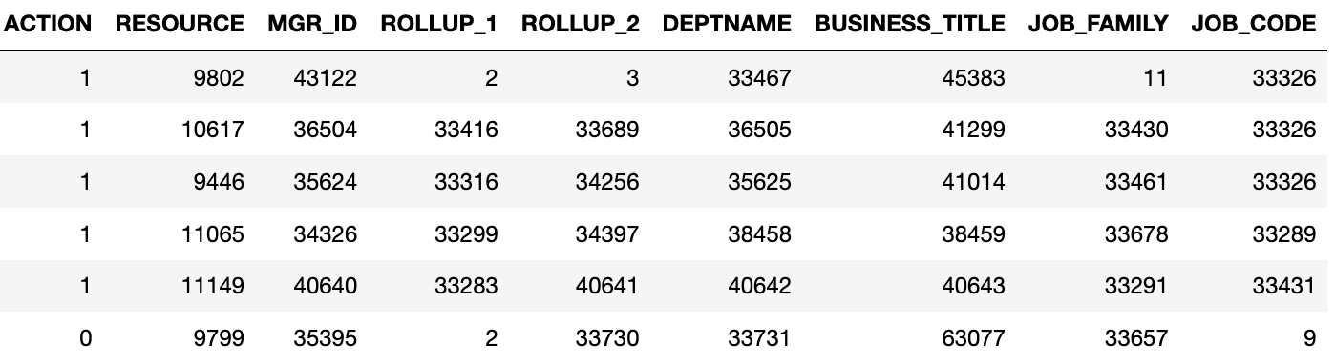
LightGBM Notebook Example
We will use lightGBM on a tabular dataset: Amazon Access Samples Data Set.
It is historical data about employees requesting resources. Binary classification: Employees were either given access or rejected.
Notebook: DTE-LECTURE-5-LIGHTGBM.ipynb

Slide 36

Catboost
A boosting method that focuses on processing categorical features and boosting trees with some “ordering principle”.
Algorithm details are explained in the paper.
The main take-away is to apply ordering principle in:
Target encoding categorical features
Boosting trees

Slide 37
Target encoding
An efficient way to deal with categorical variables is to substitute them with numerical values (usually some target statistics).
Mean Target Encoding: Replace categoricals with mean target value for them.
Example:
color | target
blue | 0
red | 1
blue | 1
blue | 1
green | 0
red | 0
color | mean_target
blue | (0+1+1)/3=0.67
red | (0+1)/2=0.5
green | 0/1=0
color | encoded_color | target
blue | 0.67 | 0
red | 0.5 | 1
blue | 0.67 | 1
blue | 0.67 | 1
green | 0 | 0
red | 0.5 | 0

Slide 38
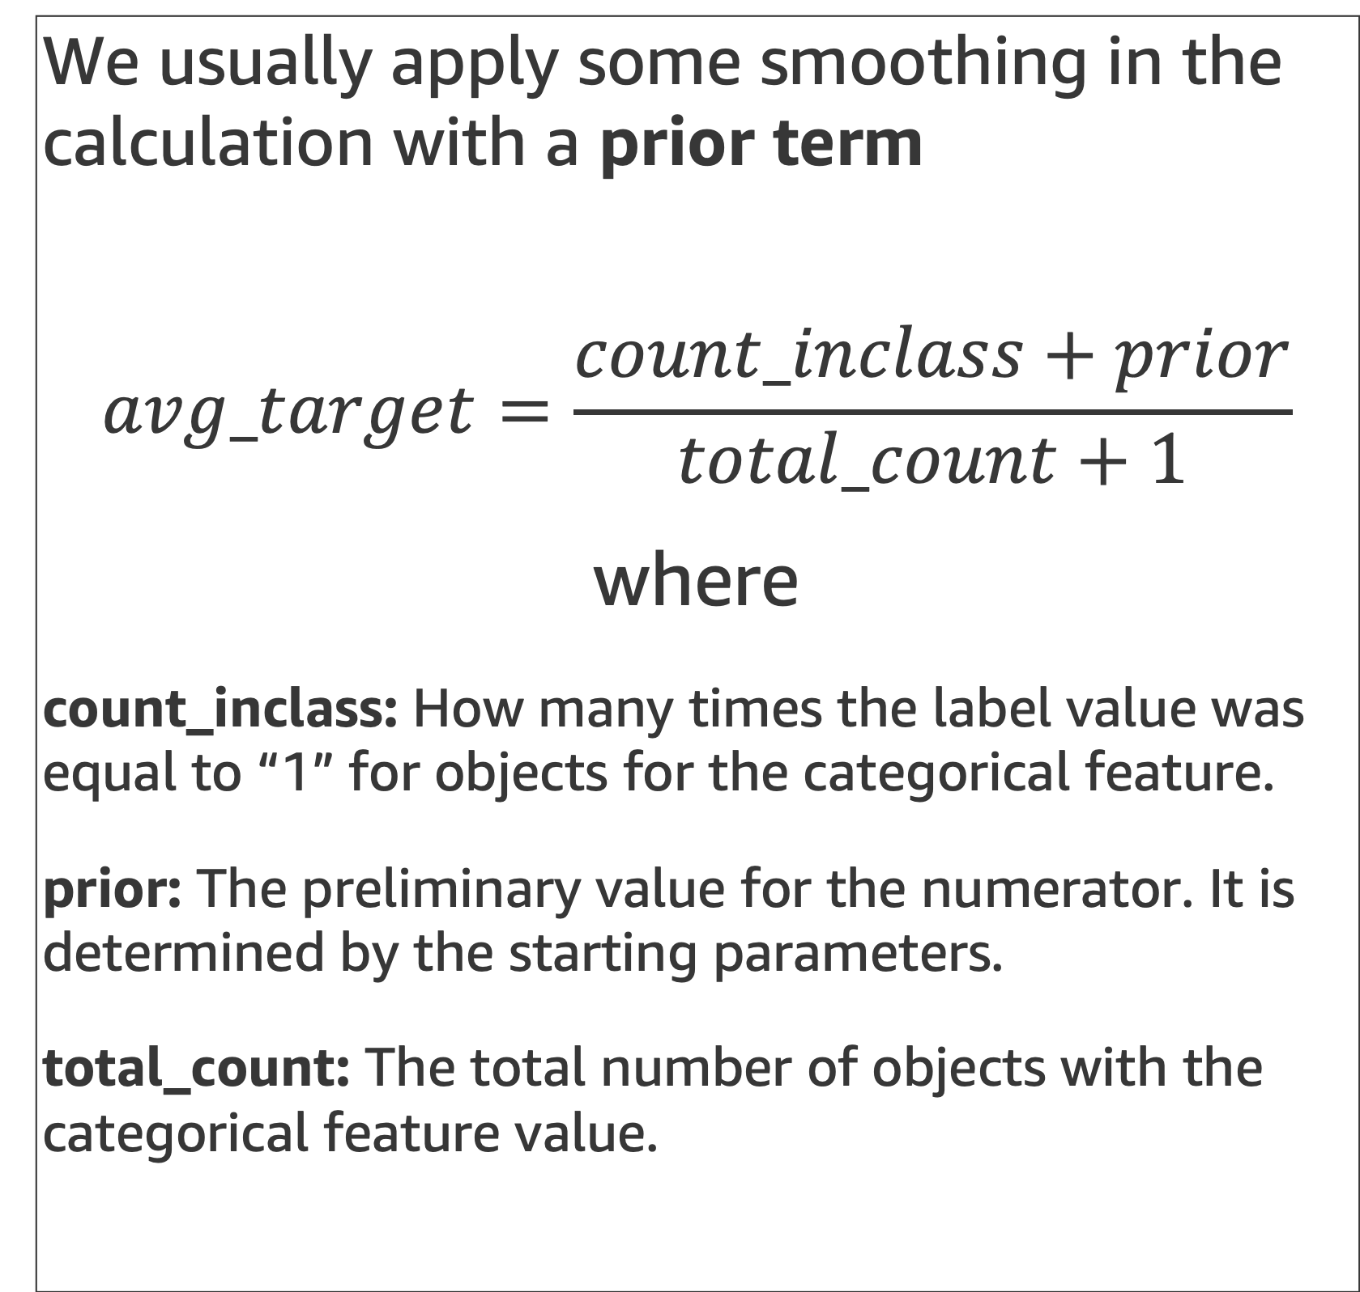
Target encoding with smoothing
We usually apply some smoothing in the calculation with a prior term
$$avg_target=\frac{count_inclass+prior}{total_count+1}$$
where
count_inclass: How many times the label value was equal to “1” for objects for the categorical feature.
prior: The preliminary value for the numerator. It is determined by the starting parameters.
total_count: The total number of objects with the categorical feature value.
Example: Assume prior=0.05
color | target
blue | 0
red | 1
blue | 1
blue | 1
green | 0
red | 0
color | target_encoding
blue | (2+0.05)/4=0.51
red | (1+0.05)/3=0.35
green | (0+0.05)/2=0.025
color | encoded_color | target
blue | 0.51 | 0
red | 0.35 | 1
blue | 0.51 | 1
blue | 0.51 | 1
green | 0.025 | 0
red | 0.35 | 0

Slide 39

Ordered target encoding
Why use “ordered” encoding? It helps prevent overfitting due to “target leakage”.
Inspired by the online learning techniques, target statistics rely only on the observed history.
$$avg_target=\frac{count_inclass+prior}{total_count+1}$$
where
count_inclass: How many times the label value was equal to “1” for objects for the categorical feature (up to the current one, not including it).
prior: The preliminary value for the numerator. It is determined by the starting parameters.
total_count: The total number of objects (up to the current one, not including it) that have a categorical feature value matching the current one.
Example: Assume prior=0.05
color | target
blue | 0
red | 1
blue | 1
blue | 1
green | 0
red | 0
color | encoded_target
blue | (0+0.05)/(0+1)=0.05

Slide 40
Ordered target encoding
Why use “ordered” encoding? It helps prevent overfitting due to “target leakage”.
Inspired by the online learning techniques, target statistics rely only on the observed history.
$$avg_target=\frac{count_inclass+prior}{total_count+1}$$
where
count_inclass: How many times the label value was equal to “1” for objects for the categorical feature (up to the current one, not including it).
prior: The preliminary value for the numerator. It is determined by the starting parameters.
total_count: The total number of objects (up to the current one, not including it) that have a categorical feature value matching the current one.
Example: Assume prior=0.05
color | target
blue | 0
red | 1
blue | 1
blue | 1
green | 0
red | 0
color | encoded_target
blue | (0+0.05)/(0+1)=0.05
red | (0+0.05)/(0+1)=0.05
Still no red before
Still no red = 1 before

Slide 41
Ordered target encoding
Why use “ordered” encoding? It helps prevent overfitting due to “target leakage”.
Inspired by the online learning techniques, target statistics rely only on the observed history.
$$avg_target=\frac{count_inclass+prior}{total_count+1}$$
where
count_inclass: How many times the label value was equal to “1” for objects for the categorical feature (up to the current one, not including it).
prior: The preliminary value for the numerator. It is determined by the starting parameters.
total_count: The total number of objects (up to the current one, not including it) that have a categorical feature value matching the current one.
Example: Assume prior=0.05
color | target
blue | 0
red | 1
blue | 1
blue | 1
green | 0
red | 0
color | encoded_target
blue | (0+0.05)/(0+1)=0.05
red | (0+0.05)/(0+1)=0.05
blue | (0+0.05)/(1+1)=0.025
Now one blue before
Still no blue = 1 before

Slide 42
Ordered target encoding
Why use “ordered” encoding? It helps prevent overfitting due to “target leakage”.
Inspired by the online learning techniques, target statistics rely only on the observed history.
$$avg_target=\frac{count_inclass+prior}{total_count+1}$$
where
count_inclass: How many times the label value was equal to “1” for objects for the categorical feature (up to the current one, not including it).
prior: The preliminary value for the numerator. It is determined by the starting parameters.
total_count: The total number of objects (up to the current one, not including it) that have a categorical feature value matching the current one.
Example: Assume prior=0.05
color | target
blue | 0
red | 1
blue | 1
blue | 1
green | 0
red | 0
color | encoded_target
blue | (0+0.05)/(0+1)=0.05
red | (0+0.05)/(0+1)=0.05
blue | (0+0.05)/(1+1)=0.025
blue | (1+0.05)/(2+1)=0.35
green | (0+0.05)/(0+1)=0.05
red | (1+0.05)/(1+1)=0.025
Now one red = 1 before
Now one red before

Slide 43
Classical Boosting
In classical boosting, we fit multiple trees using the whole dataset (x_{n}). This can lead to overfitting.
Data points
Tree 1
Tree 2
Tree m
1
2
……
+
3
4
5
(Fit on residuals from Tree 1)
(Fit on residuals from previous iteration)
…
…
…
n

Slide 44
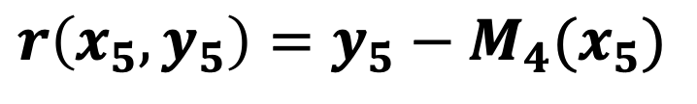
Ordered boosting
Assume model M_{i} was trained on the first i data points.
We compute residuals at each data point i using model M_{i-1} (use a tree that didn’t see that data point before)
Data points
1
2
M₄
3
4
5
$$r\left(x_{5},y_{5}\right)=y_{5}−M_{4}(x_{5})$$
6
…
…
n

Slide 45
Ordered boosting
Assume model M_{i} was trained on the first i data points.
We compute residuals at each data point i using model M_{i-1} (use a tree that didn’t see that data point before)
Data points
We need to have n separate trees to make this work (not feasible).
In practical application, we only work with trees at locations 2^{j} where j=1, 2, …, log₂(n).
1
2
M₄
3
4
5
$$r\left(x_{5},y_{5}\right)=y_{5}−M_{4}(x_{5})$$
6
…
…
n

Slide 46
XGBoost vs LightGBM vs CatBoost
 | XGBoost | LightGBM | CatBoost
Categorical variables | Needs to be one-hot-encoded or target-encoded beforehand | Set column type as “category” in data frame, or Use categorical_feature parameter | Set column type as “category” in data frame, or Use cat_features parameter
Missing values | Branch directions are learned for missing values | Skips the data point during split, allocates later to leaves | Numerical missing values are set to min value for that feature (default)

Slide 47
CatBoost Notebook Example
We will use CatBoost on a tabular dataset: Amazon Access Samples Data Set.
It is historical data about employees requesting resources. Binary classification: Employees were either given access or rejected.
Notebook: DTE-LECTURE-5-CATBOOST.ipynb

Slide 48
Agenda
Class review
Motivating Boosting
Gradient Boosting
Gradient Boosting Libraries
XGBoost
LightGBM
CatBoost

Slide 49
Final Project – Predict Pet Adoption Time
You will working with pet adoption data from Austin Animal Center.
We joined two datasets that cover intake and outcome of animals. Intake data is available from here and outcome is from here.
We want you to predict whether a pet is adopted within the 30 days stay time in the animal center.
We give you a starter notebook: DTE-FINAL-PROJECT.ipynb
Dataset schema:
Pet ID - Unique ID of pet
Outcome Type - State of pet at the time of recording the outcome
Sex upon Outcome - Sex of pet at outcome
Name - Name of pet
Found Location - Found location of pet before entered the center
Intake Type - Circumstances bringing the pet to the center
Intake Condition - Health condition of pet when entered the center
Pet Type - Type of pet
Sex upon Intake - Sex of pet when entered the center
Breed - Breed of pet
Color - Color of pet
Age upon Intake Days - Age of pet when entered the center (days)
Time at Center - Time at center (0 = less than 30 days; 1 = more than 30 days). This is the value to predict.

Slide 50
Libraries-tools and licenses
Numpy: BSD
Pandas: BSD
Sagemaker: Apache license 2.0
Seaborn: BSD
Sklearn: BSD
Matplotlib: BSD
CatBoost: Apache license 2.0
LightGBM: MIT
XGBoost: Apache license 2.0
MXNet: Apache license 2.0

